Slide 1
Algorithms complexity and optimization
Romain Lhotte

Slide 2
Plan
Seq 1: Introduction, probably things you already know, primes and fast exponentiation
Seq 2: Abstract Data Type & Data Structure. Array & Linked Lists.
Seq 3: Queue & Stack. Sorting.
Seq 4: Sets with arrays. Two Pointers.
Seq 5: Some exercises. Set with hashing.
Seq 6-8: Graphs (slide dominant), trees, DFS, BFS, priority queues
Seq 9: Exercises
Seq 10: Exam (MCQ & 2 coding exercises & GPT/Copilot not allowed)

Slide 3
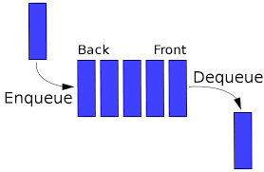
Queue
First In First Out

Slide 4
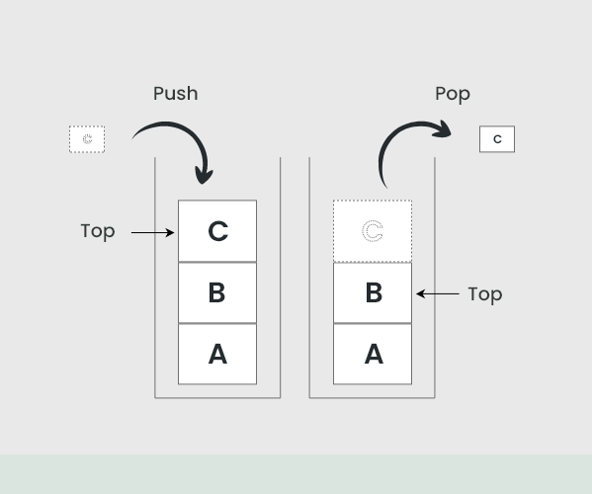
Stack
Last In First Out

Slide 5
Double Ended Queue (new data structure !)
.append (append on the right) O(1)
.appendleft (append on the left) O(1)
.pop (remove the last element on the right) O(1)
.popleft (remove the first element) O(1)
Use a doubly linked list under the hood (linked lists implemented with arrays for greater efficiency but that’s out of the scope of the class)

Slide 6
In practice
So far:
Static arrays => rarely used (never in Python, sometimes in other languages)
Dynamic arrays => frequently used
Linked lists => almost never used in practice but useful to understand theory (for two reasons: deque is built on a doubly linked list and will be useful when we see trees)
Queues and stacks => Queues very often used. Stacks are very often used but are just dynamic arrays.
Soon:
Sets, dictionaries, graphs, trees. All frequently used.

Slide 7
Some exercises
https://leetcode.com/problems/backspace-string-compare/
https://leetcode.com/problems/valid-parentheses/
A harder exercice on the platform we will have the exam on

Slide 8
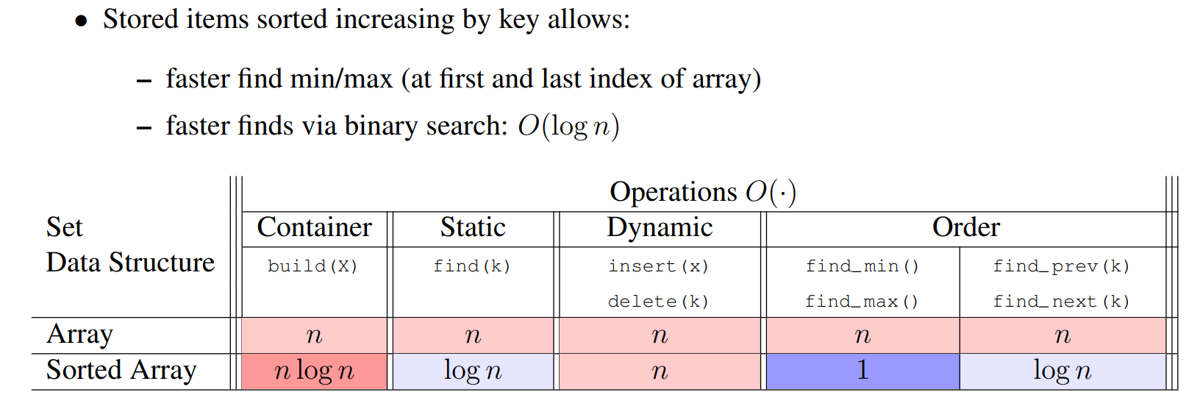
Sorting

Slide 9
